Slide 1

Shared Human-Robot Control in Wheeled Soccer Robots
30/06/25
Tobias Wejbora
Mechanical Engineering, Robotics Group

Slide 2
Table of Contents
Motivation
Methodology
Shared Control Logic
Future Work

Slide 3
Motivation

Slide 4
The problem
Pure manual control is difficult and unsafe
No support for learning by demonstration
Demonstrations and public events have limited engagement

Slide 5
The goal of this implementation
Enable research on human strategy (learning by demonstration)
Create an interactive platform for demonstrations

Slide 6
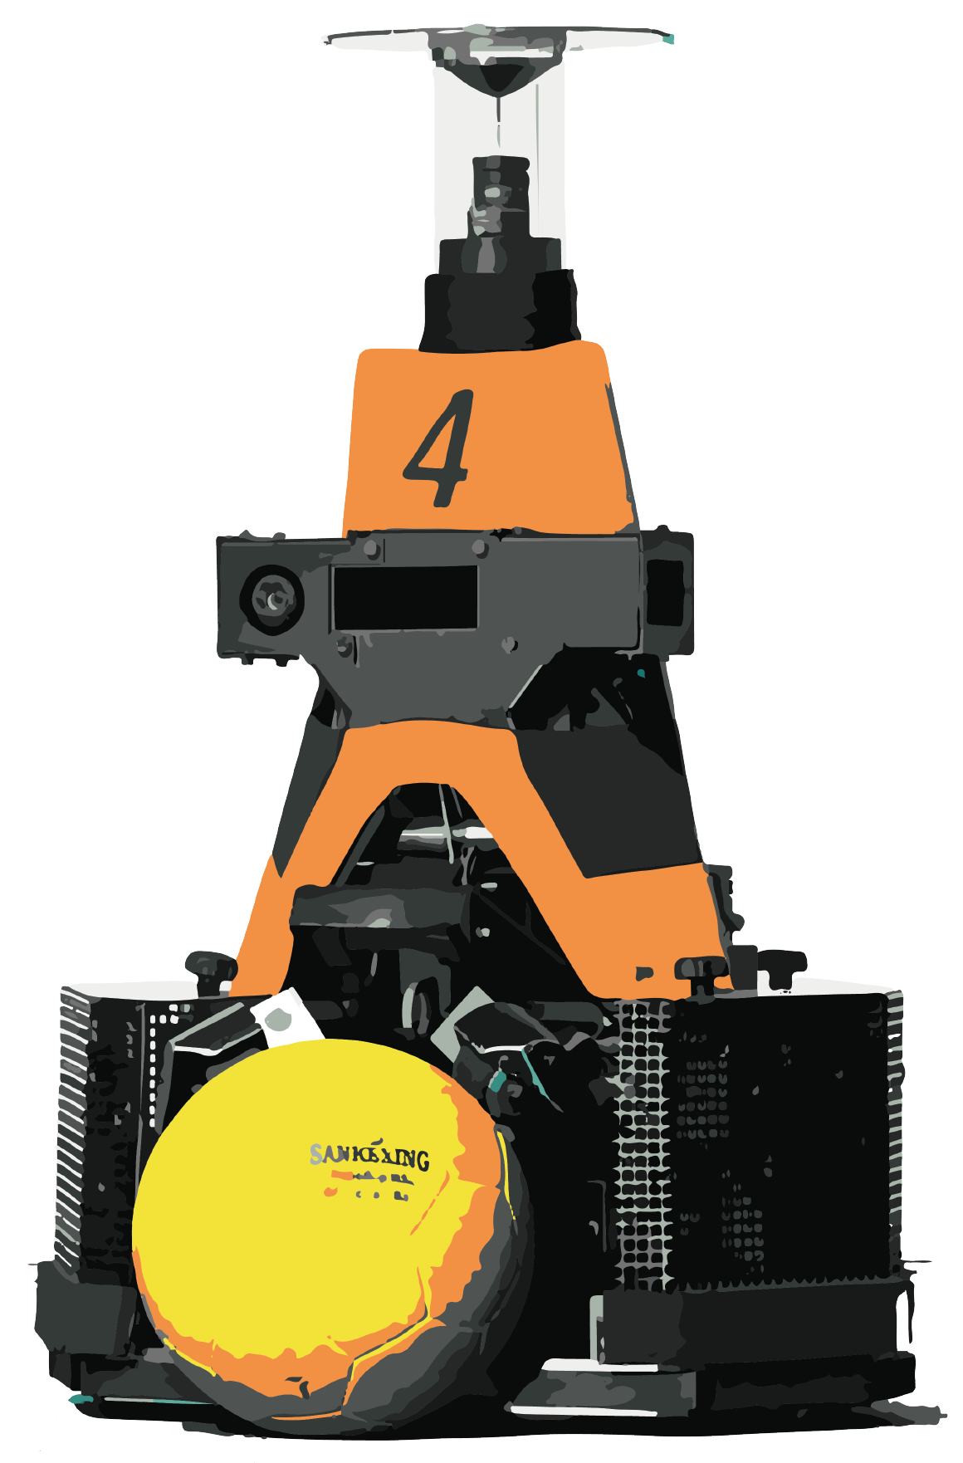
What is Shared Control?
Manual Mode
Autonomous Mode

Slide 7
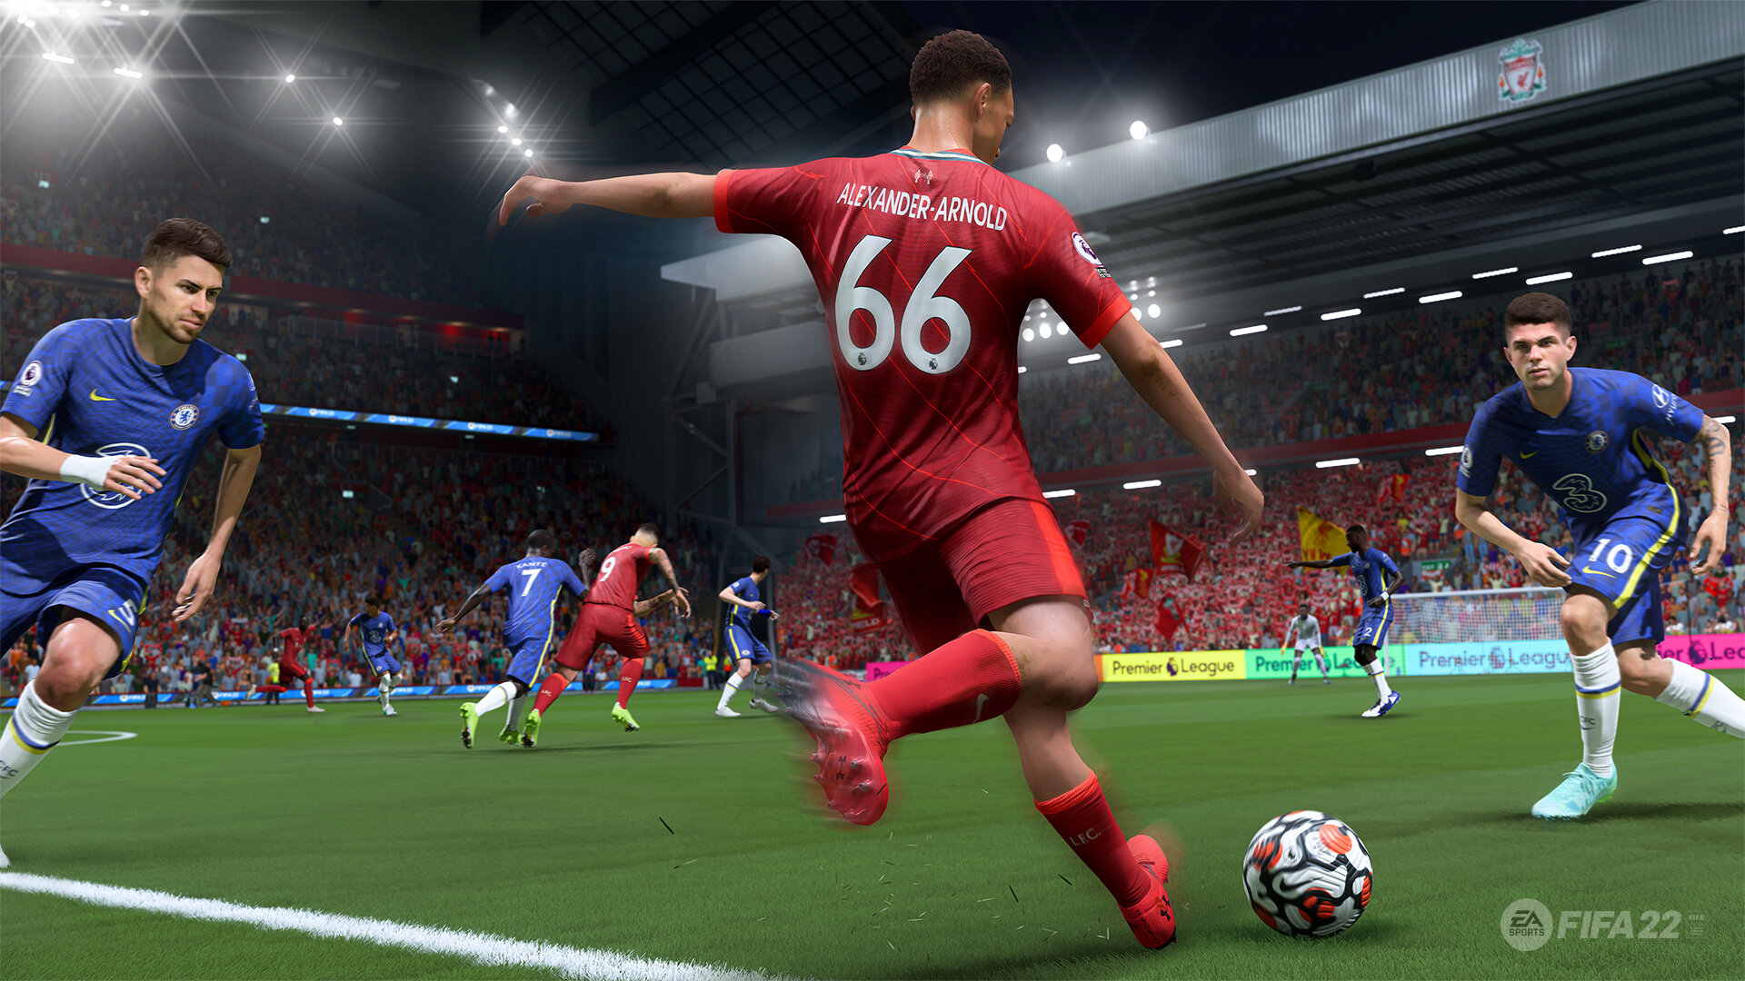

What is Shared Control?
Manual Mode
Autonomous Mode

Slide 8
How is manual mode different from FIFA?
Human Robot Interaction
There is clearly some level of assistance​.

Slide 9
Methodology

Slide 10
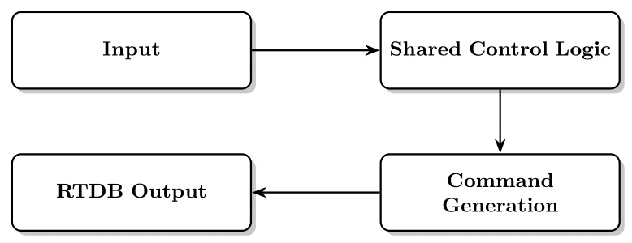
Overall System Methodology

Slide 11
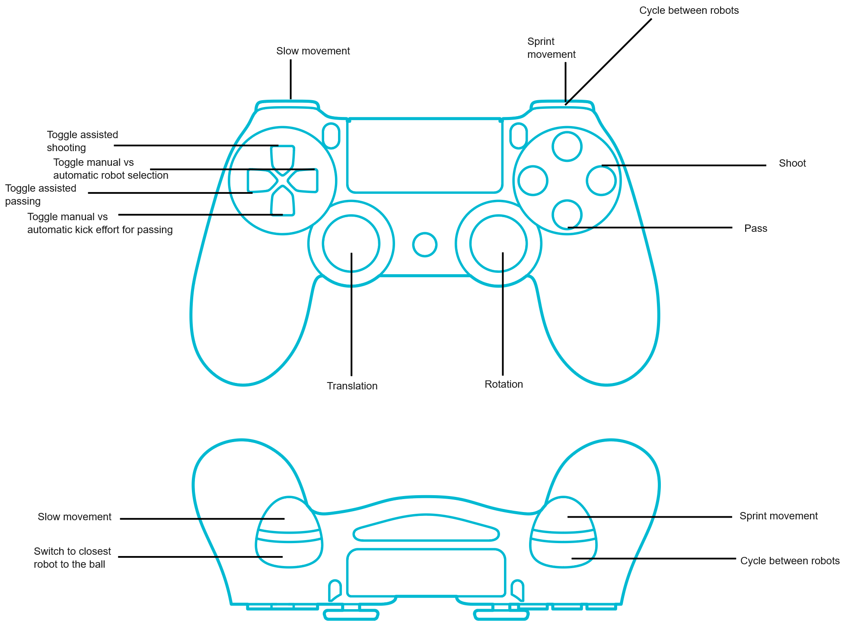
Input Module
Human Input
  Keyboard
  Joystick
Autonomous(RTDB) Input
  Ball Position
  Robot Positions
  Field Parameters
  Obstacles

Slide 12
Shared Control Logic
Goal: Balance autonomous assistance with human strategic intent
Communication has to be bi-directional
Cognitive workload and offloading
Key Features:
Field Boundary Impedance
Automatic Ball Intercept
Assisted Passing
Assisted Shooting
Switching between Robots

Slide 13
Command Generation & RTDB Output
Command Generation:
    Movement Commands (Velocities, Rotation)
    Shooting Commands (Flat Shot/Lob Shot)
RTDB Output
    Commands to individual robots
    Refbox Commands

Slide 14
Shared-Control Logic

Slide 15
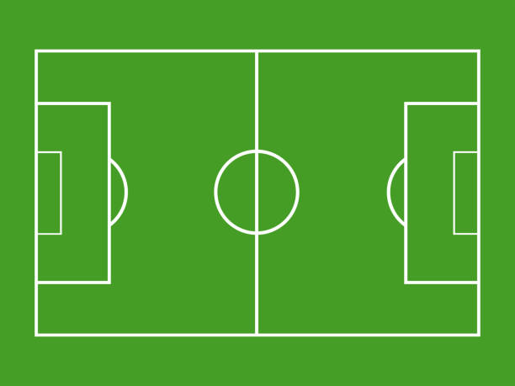
Field Boundary Impedance
Predicts the stopping position
Stopping point within field boundaries?
Limit the velocity
Why is this feature important?
Safety

Slide 16
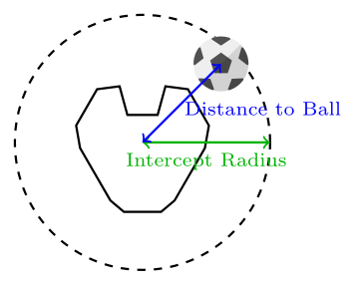
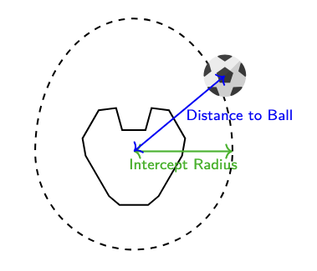
Automatic Ball Intercept
Manual intercept of the ball is difficult and time consuming
Good
Better

Slide 17
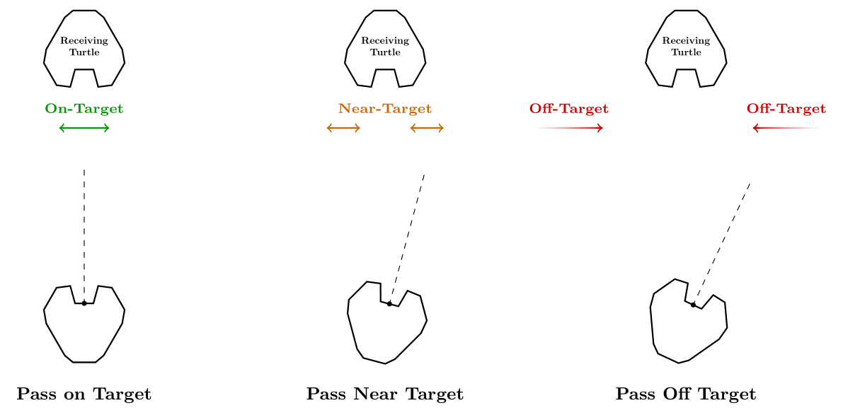
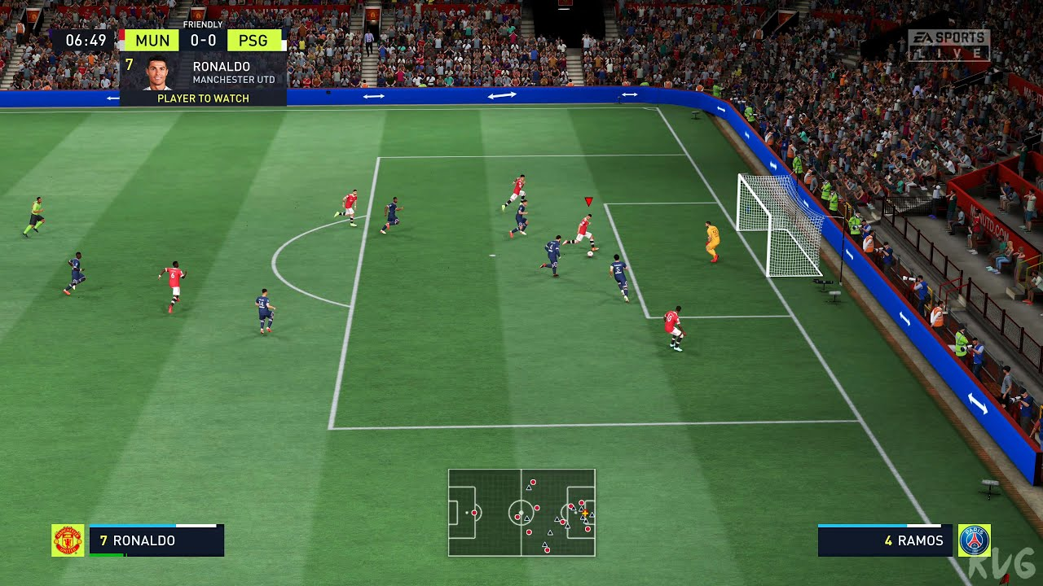
Assisted Passing
Aiming can be difficult
  Point of view

Slide 18
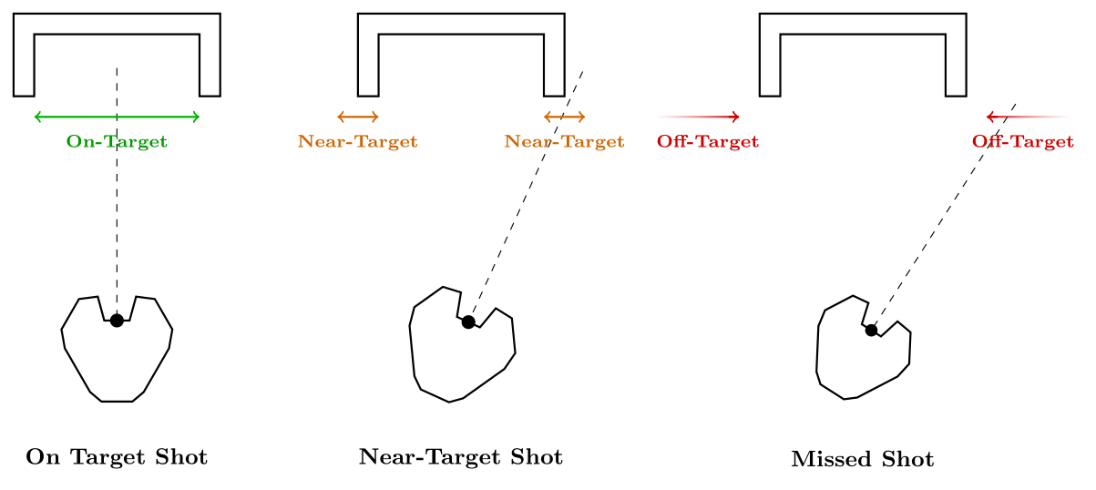
Assisted Shooting
Aiming can be difficult
  Point of view

Slide 19
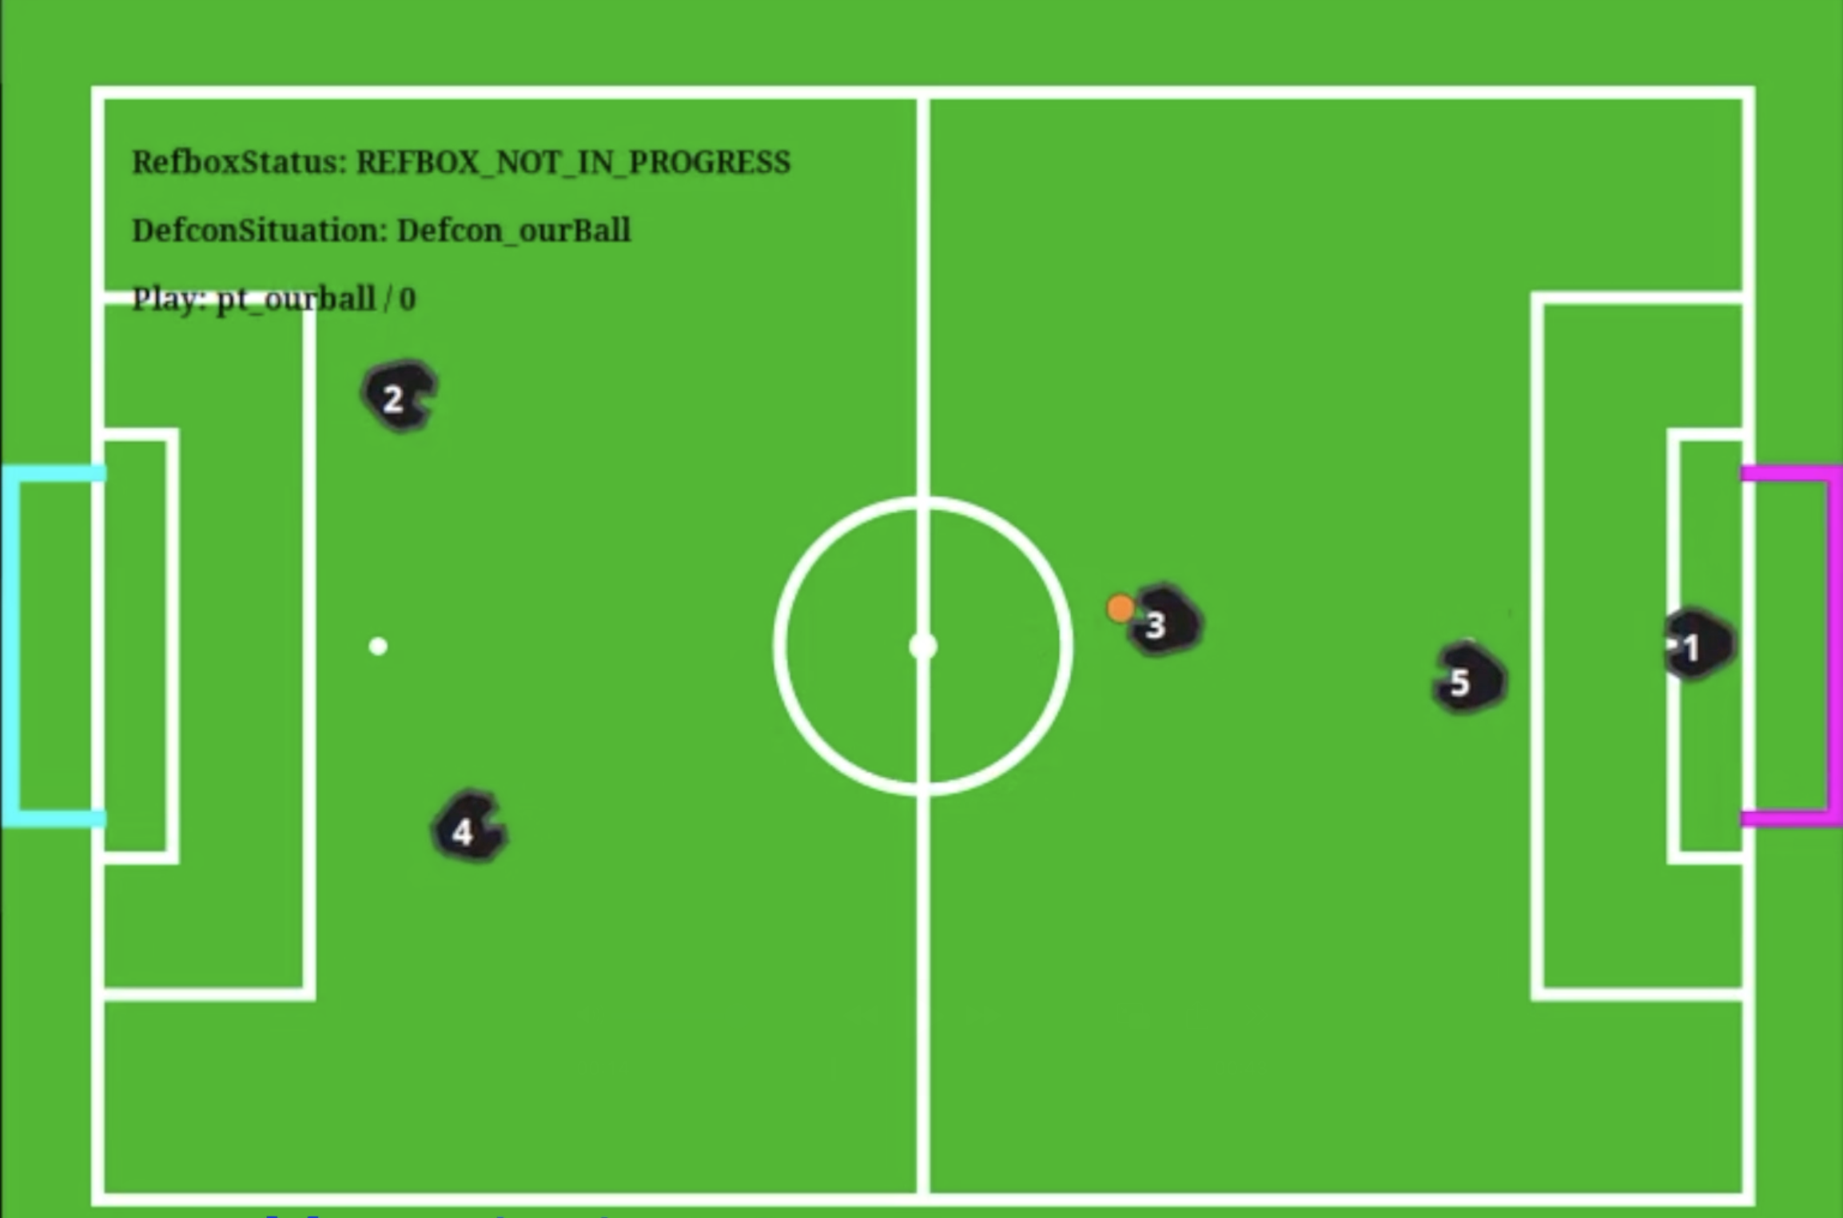
Switching between turtles
System auto-switches to:
    Robot with ball possession
    Closest to the ball (when desired by operator)
  The operator selects robots directly:
    Using keys 1–6 or R1 button
Why?
Reduces cognitive load — keeps gameplay fluid
Enables operator to focus on strategic decisions (passing, positioning)

Slide 20
Results

Slide 21

Field Boundary Impedance

Slide 22
Automatic Ball Intercept

Slide 23
Assisted Shooting

Slide 24
Assisted Passing

Slide 25
Switching between turtles

Slide 26
Future Work

Slide 27
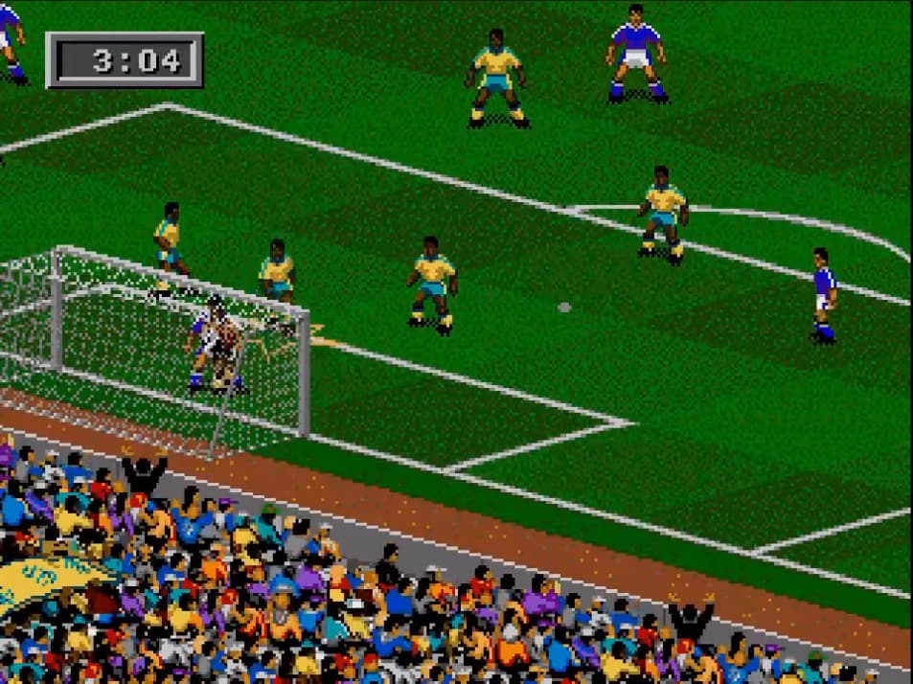
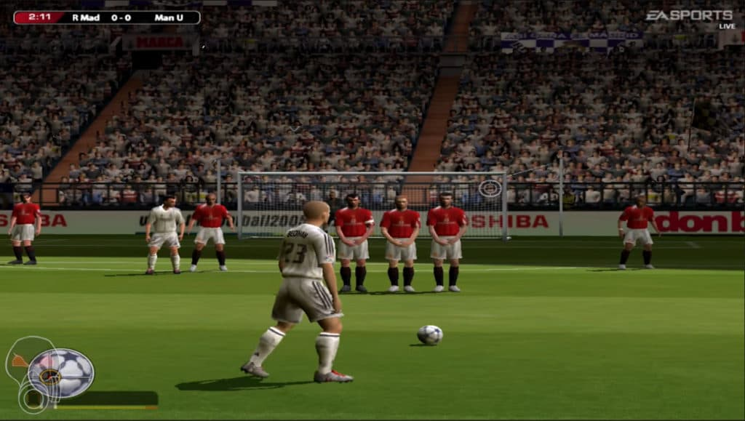
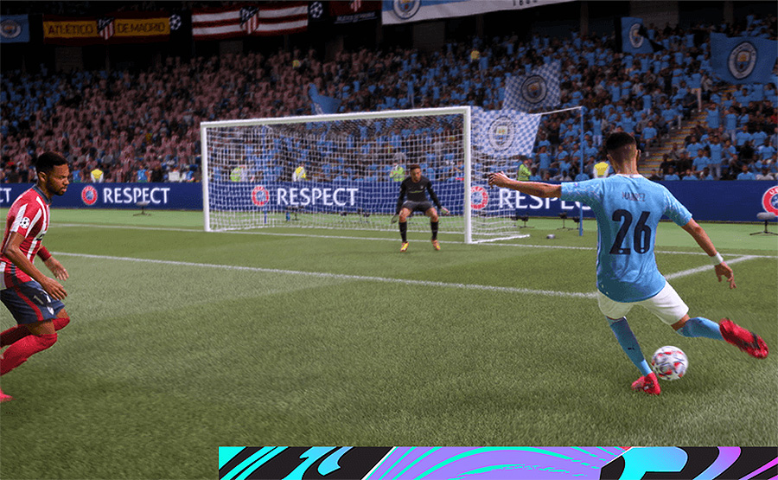
Future Work
FIFA 95
FIFA 2004
FIFA 25

Slide 28
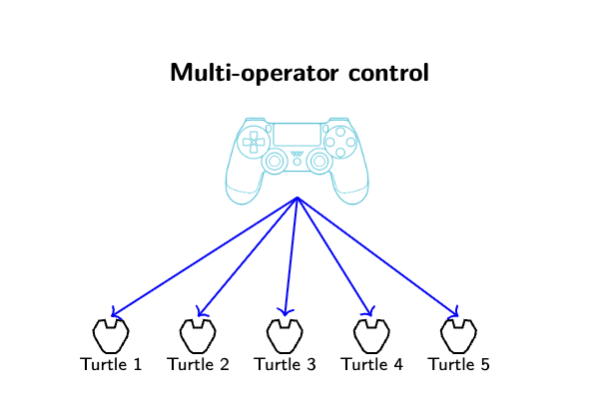
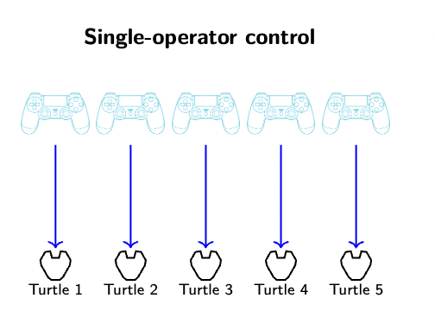
Future Work
Field Boundary Logic
    Edge cases: Throw in's, strategy
Automatic Ball Intercept
    Take into account ball velocity
Switching between turtles
    Based on role, strategy.
Assisted Obstacle Avoidance

Slide 29
Thank you for listening
Mechanical Engineering, Robotics Group

